Slide 1
ITDO6014 AI AND DS-1
Module 3: Knowledge Representation

Slide 2
Knowledge-Based Agent
An intelligent agent needs knowledge about the real world for taking decisions and reasoning to act efficiently.
Knowledge-based agents are those agents who have the capability of maintaining an internal state of knowledge, reason over that knowledge, update their knowledge after observations and take actions. These agents can represent the world with some formal representation and act intelligently.
Knowledge-based agents are composed of two main parts:
Knowledge-base and
Inference system.

Slide 3
Knowledge-Based Agent
A knowledge-based agent must able to do the following:
An agent should be able to represent states, actions, etc.
An agent Should be able to incorporate new percepts
An agent can update the internal representation of the world
An agent can deduce the internal representation of the world
An agent can deduce appropriate actions

Slide 4
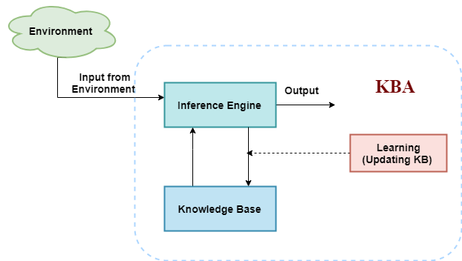
Knowledge-Based Agent
The architecture of knowledge-based agent:

Slide 5
Knowledge-Based Agent
The above diagram is representing a generalized architecture for a knowledge-based agent. The knowledge-based agent (KBA) take input from the environment by perceiving the environment. The input is taken by the inference engine of the agent and which also communicate with KB to decide as per the knowledge store in KB. The learning element of KBA regularly updates the KB by learning new knowledge.

Slide 6
Knowledge-Based Agent
Knowledge base: Knowledge-base is a central component of a knowledge-based agent, it is also known as KB. It is a collection of sentences (here 'sentence' is a technical term and it is not identical to sentence in English). These sentences are expressed in a language which is called a knowledge representation language. The Knowledge-base of KBA stores fact about the world.
Knowledge-base is required for updating knowledge for an agent to learn with experiences and take action as per the knowledge.

Slide 7
Knowledge-Based Agent
Inference system: Inference means deriving new sentences from old. Inference system allows us to add a new sentence to the knowledge base. A sentence is a proposition about the world. Inference system applies logical rules to the KB to deduce new information.
Inference system generates new facts so that an agent can update the KB. An inference system works mainly in two rules which are given as:
Forward chaining
Backward chaining

Slide 8
Knowledge-Based Agent
Following are three operations which are performed by KBA in order to show the intelligent behavior:
TELL: This operation tells the knowledge base what it perceives from the environment.
ASK: This operation asks the knowledge base what action it should perform.
Perform: It performs the selected action.

Slide 9
Knowledge-Based Agent
Following is the structure outline of a generic knowledge-based agents program:
function KB-AGENT(percept):
persistent: KB, a knowledge base
t, a counter, initially 0, indicating time
TELL(KB, MAKE-PERCEPT-SENTENCE(percept, t))
Action = ASK(KB, MAKE-ACTION-QUERY(t))
TELL(KB, MAKE-ACTION-SENTENCE(action, t))
t = t + 1
return action

Slide 10
Knowledge-Based Agent
The knowledge-based agent takes percept as input and returns an action as output. The agent maintains the knowledge base, KB, and it initially has some background knowledge of the real world. It also has a counter to indicate the time for the whole process, and this counter is initialized with zero.
Each time when the function is called, it performs its three operations:
Firstly it TELLs the KB what it perceives.
Secondly, it asks KB what action it should take
Third agent program TELLS the KB that which action was chosen.

Slide 11
Knowledge-Based Agent
The MAKE-PERCEPT-SENTENCE generates a sentence as setting that the agent perceived the given percept at the given time.
The MAKE-ACTION-QUERY generates a sentence to ask which action should be done at the current time.
MAKE-ACTION-SENTENCE generates a sentence which asserts that the chosen action was executed.

Slide 12
Knowledge-Based Agent
Various levels of knowledge-based agent:
A knowledge-based agent can be viewed at different levels which are given below:
1. Knowledge level
Knowledge level is the first level of knowledge-based agent, and in this level, we need to specify what the agent knows, and what the agent goals are. With these specifications, we can fix its behavior. For example, suppose an automated taxi agent needs to go from a station A to station B, and he knows the way from A to B, so this comes at the knowledge level.

Slide 13
Knowledge-Based Agent
2. Logical level:
At this level, we understand that how the knowledge representation of knowledge is stored. At this level, sentences are encoded into different logics. At the logical level, an encoding of knowledge into logical sentences occurs. At the logical level we can expect to the automated taxi agent to reach to the destination B.
3. Implementation level:
This is the physical representation of logic and knowledge. At the implementation level agent perform actions as per logical and knowledge level. At this level, an automated taxi agent actually implement his knowledge and logic so that he can reach to the destination.

Slide 14
Knowledge-Based Agent
Approaches to designing a knowledge-based agent:
There are mainly two approaches to build a knowledge-based agent:
1. Declarative approach: We can create a knowledge-based agent by initializing with an empty knowledge base and telling the agent all the sentences with which we want to start with. This approach is called Declarative approach.
2. Procedural approach: In the procedural approach, we directly encode desired behavior as a program code. Which means we just need to write a program that already encodes the desired behavior or agent.

Slide 15
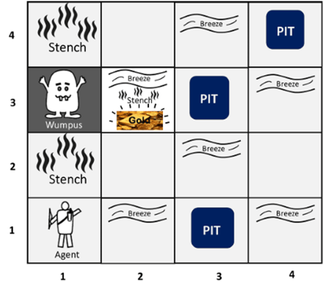
Knowledge-Based Agent
The Wumpus World in Artificial intelligence

Slide 16
Knowledge-Based Agent
There are also some components which can help the agent to navigate the cave. These components are given as follows:
The rooms adjacent to the Wumpus room are smelly, so that it would have some stench.
The room adjacent to PITs has a breeze, so if the agent reaches near to PIT, then he will perceive the breeze.
There will be glitter in the room if and only if the room has gold.
The Wumpus can be killed by the agent if the agent is facing to it, and Wumpus will emit a horrible scream which can be heard anywhere in the cave.

Slide 17
Knowledge-Based Agent
PEAS description of Wumpus world:
To explain the Wumpus world we have given PEAS description as below:
Performance measure:
+1000 reward points if the agent comes out of the cave with the gold.
-1000 points penalty for being eaten by the Wumpus or falling into the pit.
-1 for each action, and -10 for using an arrow.
The game ends if either agent dies or came out of the cave.

Slide 18
Knowledge-Based Agent
Actuators:
Left turn,
Right turn
Move forward
Grab
Release
Shoot.

Slide 19
Knowledge-Based Agent
Sensors: The agent will perceive the stench if he is in the room adjacent to the Wumpus. (Not diagonally).
The agent will perceive breeze if he is in the room directly adjacent to the Pit.
The agent will perceive the glitter in the room where the gold is present.
The agent will perceive the bump if he walks into a wall.
When the Wumpus is shot, it emits a horrible scream which can be perceived anywhere in the cave.
These percepts can be represented as five element list, in which we will have different indicators for each sensor.
Example if agent perceives stench, breeze, but no glitter, no bump, and no scream then it can be represented as: [Stench, Breeze, None, None, None].

Slide 20
Knowledge-Based Agent
The Wumpus world Properties:
Partially observable: The Wumpus world is partially observable because the agent can only perceive the close environment such as an adjacent room.
Deterministic: It is deterministic, as the result and outcome of the world are already known.
Sequential: The order is important, so it is sequential.
Static: It is static as Wumpus and Pits are not moving.
Discrete: The environment is discrete.
One agent: The environment is a single agent as we have one agent only and Wumpus is not considered as an agent.

Slide 21
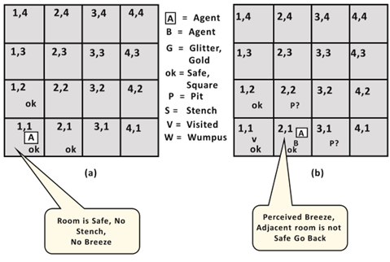
Knowledge-Based Agent

Slide 22
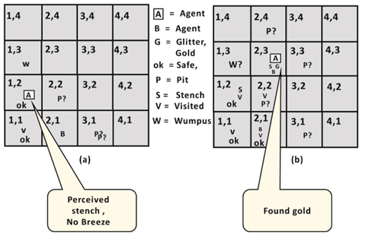
Knowledge-Based Agent

Slide 23
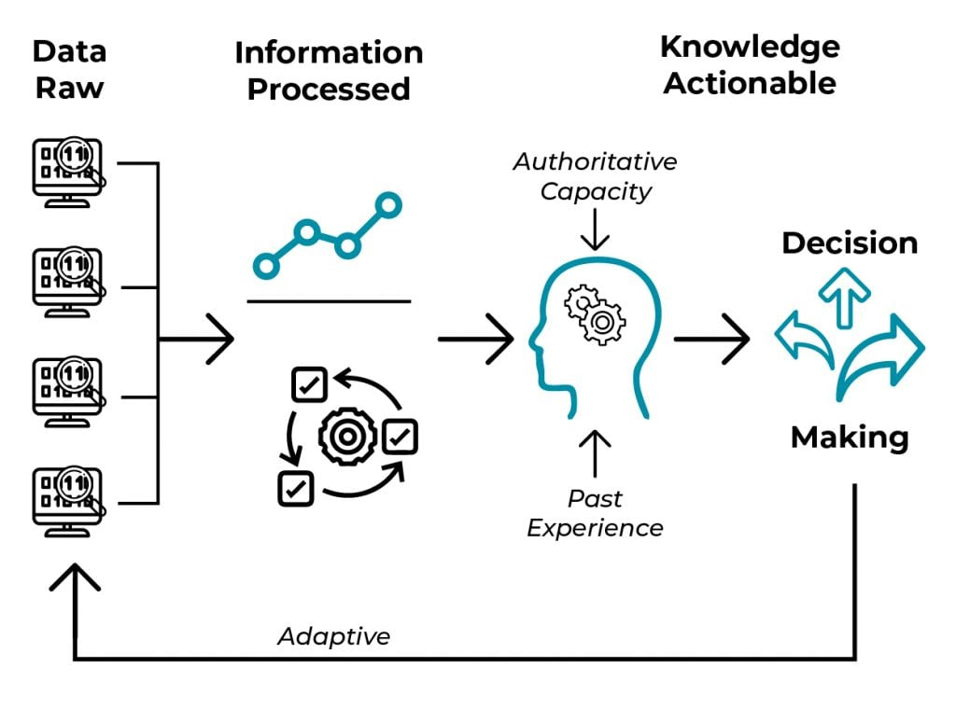
Knowledge Representation

Slide 24
Knowledge Representation
Humans are best at understanding, reasoning, and interpreting knowledge. Human knows things, which is knowledge and as per their knowledge they perform various actions in the real world. But how machines do all these things comes under knowledge representation and reasoning. Hence we can describe Knowledge representation as following:
Knowledge representation and reasoning (KR, KRR) is the part of Artificial intelligence which concerned with AI agents thinking and how thinking contributes to intelligent behavior of agents.

Slide 25
Knowledge Representation
It is responsible for representing information about the real world so that a computer can understand and can utilize this knowledge to solve the complex real world problems such as diagnosis a medical condition or communicating with humans in natural language.
It is also a way which describes how we can represent knowledge in artificial intelligence. Knowledge representation is not just storing data into some database, but it also enables an intelligent machine to learn from that knowledge and experiences so that it can behave intelligently like a human.

Slide 26
Knowledge Representation
Following are the kind of knowledge which needs to be represented in AI systems:
Object: All the facts about objects in our world domain. E.g., Guitars contains strings, trumpets are brass instruments.
Events: Events are the actions which occur in our world.
Performance: It describe behavior which involves knowledge about how to do things.
Meta-knowledge: It is knowledge about what we know.

Slide 27
Knowledge Representation
Facts: Facts are the truths about the real world and what we represent.

Slide 28
Knowledge Representation
Approaches to knowledge representation:
There are mainly four approaches to knowledge representation, which are given below:
1. Simple relational knowledge:
It is the simplest way of storing facts which uses the relational method, and each fact about a set of the object is set out systematically in columns.
This approach of knowledge representation is famous in database systems where the relationship between different entities is represented.

Slide 29
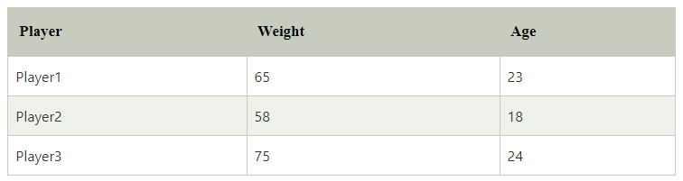
Knowledge Representation
Example: The following is the simple relational knowledge representation.

Slide 30
Knowledge Representation
2. Inheritable knowledge:
In the inheritable knowledge approach, all data must be stored into a hierarchy of classes.
All classes should be arranged in a generalized form or a hierarchical manner.
In this approach, we apply inheritance property.
Elements inherit values from other members of a class.

Slide 31
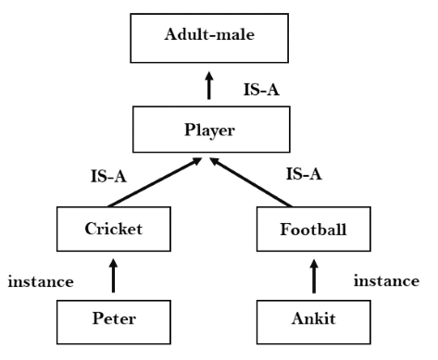
Knowledge Representation

Slide 32
Knowledge Representation
Inferential knowledge:
Inferential knowledge approach represents knowledge in the form of formal logics.
This approach can be used to derive more facts.
It guaranteed correctness.
Example: Let's suppose there are two statements:
Marcus is a man
All men are mortal Then it can represent as; man(Marcus) ∀x = man (x) ----------> mortal (x)s

Slide 33
Knowledge Representation
Techniques of knowledge representation
There are mainly four ways of knowledge representation which are given as follows:
Logical Representation
Semantic Network Representation
Frame Representation

Slide 34
Knowledge Representation
1. Logical Representation
Logical representation is a language with some concrete rules which deals with propositions and has no ambiguity in representation. Logical representation means drawing a conclusion based on various conditions. This representation lays down some important communication rules. It consists of precisely defined syntax and semantics which supports the sound inference. Each sentence can be translated into logics using syntax and semantics.

Slide 35
Knowledge Representation
Syntax:
Syntaxes are the rules which decide how we can construct legal sentences in the logic.
It determines which symbol we can use in knowledge representation.
How to write those symbols.

Slide 36
Knowledge Representation
Semantics:
Semantics are the rules by which we can interpret the sentence in the logic.
Semantic also involves assigning a meaning to each sentence.
Logical representation can be categorised into mainly two logics:
Propositional Logics
Predicate logics

Slide 37
Knowledge Representation
2. Semantic Network Representation
Semantic networks are alternative of predicate logic for knowledge representation. In Semantic networks, we can represent our knowledge in the form of graphical networks. This network consists of nodes representing objects and arcs which describe the relationship between those objects. Semantic networks can categorize the object in different forms and can also link those objects. Semantic networks are easy to understand and can be easily extended.

Slide 38
Knowledge Representation
This representation consist of mainly two types of relations:
IS-A relation (Inheritance)
Kind-of-relation
Example: Following are some statements which we need to represent in the form of nodes and arcs.

Slide 39
Knowledge Representation
Statements:
Jerry is a cat.
Jerry is a mammal
Jerry is owned by Priya.
Jerry is brown colored.
All Mammals are animal.

Slide 40
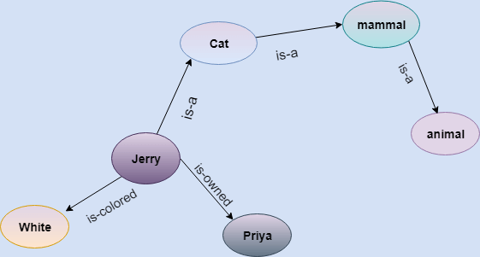
Knowledge Representation

Slide 41
Knowledge Representation
3. Frame Representation
A frame is a record like structure which consists of a collection of attributes and its values to describe an entity in the world. Frames are the AI data structure which divides knowledge into substructures by representing stereotypes situations. It consists of a collection of slots and slot values. These slots may be of any type and sizes. Slots have names and values which are called facets.

Slide 42
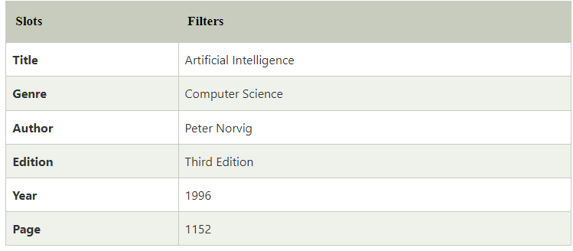
Knowledge Representation
Example: 1
Let's take an example of a frame for a book

Slide 43
Knowledge Representation
Propositional logic:
Propositional logic (PL) is the simplest form of logic where all the statements are made by propositions. A proposition is a declarative statement which is either true or false. It is a technique of knowledge representation in logical and mathematical form.
Example:
a) It is Sunday.
b) The Sun rises from West (False proposition)
c) 3+3= 7(False proposition)
d) 5 is a prime number.

Slide 44
Knowledge Representation
Following are some basic facts about propositional logic:
Propositional logic is also called Boolean logic as it works on 0 and 1.
In propositional logic, we use symbolic variables to represent the logic, and we can use any symbol for a representing a proposition, such A, B, C, P, Q, R, etc.
Propositions can be either true or false, but it cannot be both.
Propositional logic consists of an object, relations or function, and logical connectives.

Slide 45
Knowledge Representation
These connectives are also called logical operators.
The propositions and connectives are the basic elements of the propositional logic.
Connectives can be said as a logical operator which connects two sentences.
A proposition formula which is always true is called tautology, and it is also called a valid sentence.
A proposition formula which is always false is called Contradiction.

Slide 46
Knowledge Representation
A proposition formula which has both true and false values is called
Statements which are questions, commands, or opinions are not propositions such as "Where is Rohini", "How are you", "What is your name", are not propositions.
Syntax of propositional logic:
The syntax of propositional logic defines the allowable sentences for the knowledge representation. There are two types of Propositions:
Atomic Propositions
Compound propositions

Slide 47
Knowledge Representation
Atomic Proposition: Atomic propositions are the simple propositions. It consists of a single proposition symbol. These are the sentences which must be either true or false.
Example:
a) 2+2 is 4, it is an atomic proposition as it is a true fact.
b) "The Sun is cold" is also a proposition as it is a false fact.

Slide 48
Knowledge Representation
Compound proposition: Compound propositions are constructed by combining simpler or atomic propositions, using parenthesis and logical connectives.
Example:
a) "It is raining today, and street is wet."
b) "Ankit is a doctor, and his clinic is in Mumbai."

Slide 49
Knowledge Representation
Conjunction: A sentence which has ∧ connective such as, P ∧ Q is called a conjunction. Example: Rohan is intelligent and hardworking. It can be written as, P= Rohan is intelligent, Q= Rohan is hardworking. → P∧ Q.
Disjunction: A sentence which has ∨ connective, such as P ∨ Q. is called disjunction, where P and Q are the propositions. Example: "Ritika is a doctor or Engineer", Here P= Ritika is Doctor. Q= Ritika is Doctor, so we can write it as P ∨ Q.

Slide 50
Knowledge Representation
Implication: A sentence such as P → Q, is called an implication. Implications are also known as if-then rules. It can be represented as If it is raining, then the street is wet. Let P= It is raining, and Q= Street is wet, so it is represented as P → Q
Biconditional: A sentence such as P⇔ Q is a Biconditional sentence, example If I am breathing, then I am alive P= I am breathing, Q= I am alive, it can be represented as P ⇔ Q.

Slide 51
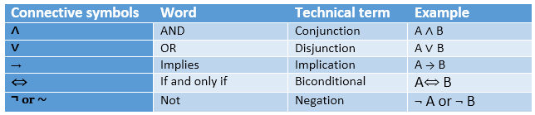
Knowledge Representation
Following is the summarized table for Propositional Logic Connectives:

Slide 52
Knowledge Representation
Truth Table:
In propositional logic, we need to know the truth values of propositions in all possible scenarios. We can combine all the possible combination with logical connectives, and the representation of these combinations in a tabular format is called Truth table. Following are the truth table for all logical connectives:

Slide 53
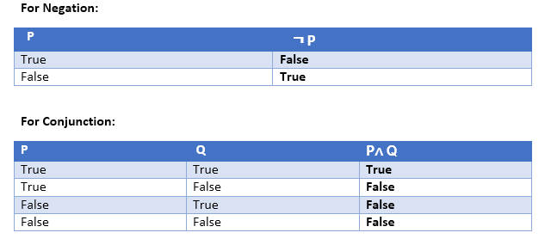
Knowledge Representation

Slide 54
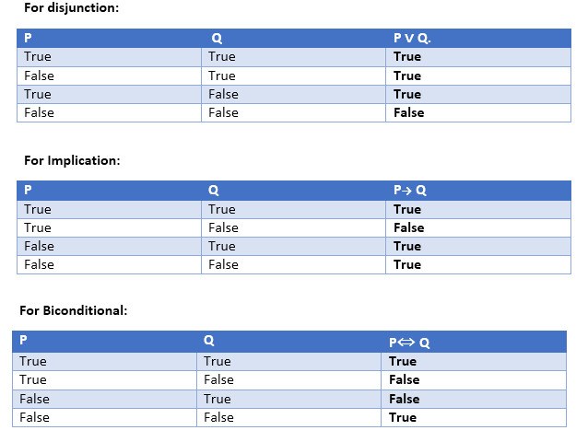
Knowledge Representation

Slide 55
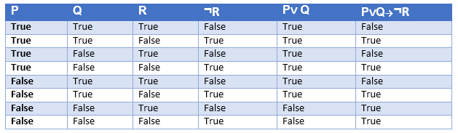
Knowledge Representation
Truth table with three propositions:
We can build a proposition composing three propositions P, Q, and R. This truth table is made-up of 8n Tuples as we have taken three proposition symbols.

Slide 56
Knowledge Representation
Logical equivalence:
Logical equivalence is one of the features of propositional logic. Two propositions are said to be logically equivalent if and only if the columns in the truth table are identical to each other.
Let's take two propositions A and B, so for logical equivalence, we can write it as A⇔B. In below truth table we can see that column for ¬A∨ B and A→B, are identical hence A is Equivalent to B

Slide 57
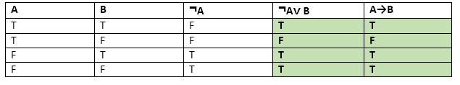
Knowledge Representation

Slide 58
Knowledge Representation
Properties of Operators:
Commutativity:
P∧ Q= Q ∧ P, or
P ∨ Q = Q ∨ P.
Associativity:
(P ∧ Q) ∧ R= P ∧ (Q ∧ R),
(P ∨ Q) ∨ R= P ∨ (Q ∨ R)
Double-negation elimination:
¬ (¬P) = P.

Slide 59
Knowledge Representation
Identity element:
P ∧ True = P,
P ∨ True= True.
Distributive:
P∧ (Q ∨ R) = (P ∧ Q) ∨ (P ∧ R).
P ∨ (Q ∧ R) = (P ∨ Q) ∧ (P ∨ R).
DE Morgan's Law:
¬ (P ∧ Q) = (¬P) ∨ (¬Q)
¬ (P ∨ Q) = (¬ P) ∧ (¬Q).

Slide 60
Knowledge Representation
Limitations of Propositional logic:
We cannot represent relations like ALL, some, or none with propositional logic. Example:
All the girls are intelligent.
Some apples are sweet.

Slide 61
Rules of Inference in Artificial intelligence
Inference:
In artificial intelligence, we need intelligent computers which can create new logic from old logic or by evidence, so generating the conclusions from evidence and facts is termed as Inference.

Slide 62
Knowledge Representation
Inference rules: In inference rules, the implication among all the connectives plays an important role. Following are some terminologies related to inference rules:
Implication: It is one of the logical connectives which can be represented as P → Q. It is a Boolean expression.
Converse: The converse of implication, which means the right-hand side proposition goes to the left-hand side and vice-versa. It can be written as Q → P.
Contrapositive: The negation of converse is termed as contrapositive, and it can be represented as ¬ Q → ¬ P.
Inverse: The negation of implication is called inverse. It can be represented as ¬ P → ¬ Q.

Slide 63
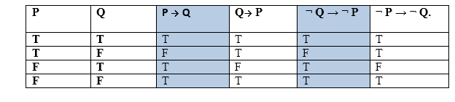
Knowledge Representation

Slide 64
Knowledge Representation
1. Modus Ponens:
The Modus Ponens rule is one of the most important rules of inference, and it states that if P and P → Q is true, then we can infer that Q will be true. It can be represented as:
Example:
Statement-1: "If I am sleepy then I go to bed" ==> P→ Q Statement-2: "I am sleepy" ==> P Conclusion: "I go to bed." ==> Q. Hence, we can say that, if P→ Q is true and P is true then Q will be true.

Slide 65
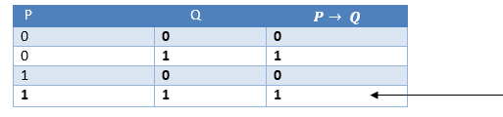
Knowledge Representation

Slide 66
Knowledge Representation
2. Modus Tollens:
The Modus Tollens rule state that if P→ Q is true and ¬ Q is true, then ¬ P will also true. It can be represented as
Statement-1: "If I am sleepy then I go to bed" ==> P→ Q Statement-2: "I do not go to the bed."==> ~Q Statement-3: Which infers that "I am not sleepy" => ~P

Slide 67
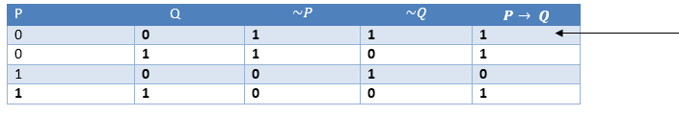
Knowledge Representation

Slide 68
Knowledge Representation
3. Hypothetical Syllogism:
The Hypothetical Syllogism rule state that if P→R is true whenever P→Q is true, and Q→R is true. It can be represented as the following notation:
Example:
Statement-1: If you have my home key then you can unlock my home. P→Q Statement-2: If you can unlock my home then you can take my money. Q→R Conclusion: If you have my home key then you can take my money. P→R

Slide 69
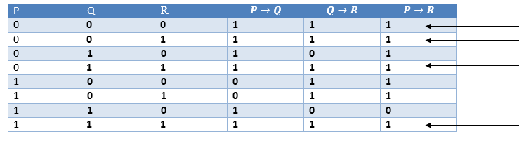
Knowledge Representation

Slide 70
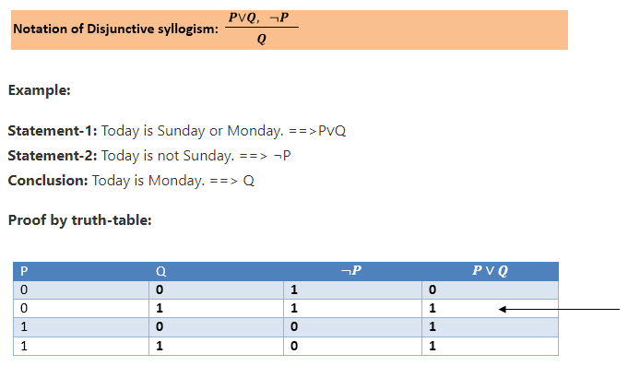
Knowledge Representation
4. Disjunctive Syllogism:
The Disjunctive syllogism rule state that if P∨Q is true, and ¬P is true, then Q will be true. It can be represented as:

Slide 71
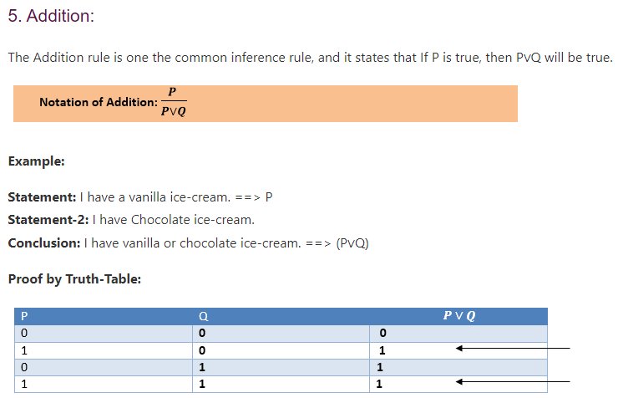
Knowledge Representation

Slide 72
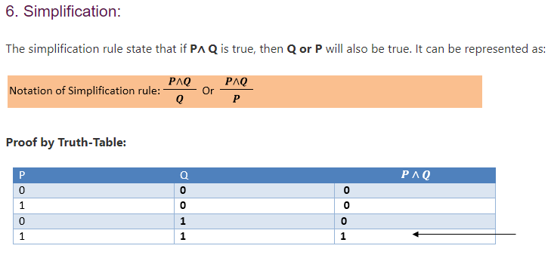
Knowledge Representation

Slide 73
First-Order Logic in Artificial intelligence
In the topic of Propositional logic, we have seen that how to represent statements using propositional logic. But unfortunately, in propositional logic, we can only represent the facts, which are either true or false. PL is not sufficient to represent the complex sentences or natural language statements. The propositional logic has very limited expressive power. Consider the following sentence, which we cannot represent using PL logic.
"Some humans are intelligent", or
"Sachin likes cricket."
To represent the above statements, PL logic is not sufficient, so we required some more powerful logic, such as first-order logic.

Slide 74
First-Order Logic in Artificial intelligence
First-Order logic
First-order logic is another way of knowledge representation in artificial intelligence. It is an extension to propositional logic.
FOL is sufficiently expressive to represent the natural language statements in a concise way.
First-order logic is also known as Predicate logic or First-order predicate logic. First-order logic is a powerful language that develops information about the objects in a more easy way and can also express the relationship between those objects.

Slide 75
First-Order Logic in Artificial intelligence
First-order logic (like natural language) does not only assume that the world contains facts like propositional logic but also assumes the following things in the world:
Objects: A, B, people, numbers, colors, wars, theories, squares, pits, wumpus, ......
Relations: It can be unary relation such as: red, round, is adjacent, or n-any relation such as: the sister of, brother of, has color, comes between
Function: Father of, best friend, third inning of, end of, ......
As a natural language, first-order logic also has two main parts:
Syntax
Semantics

Slide 76
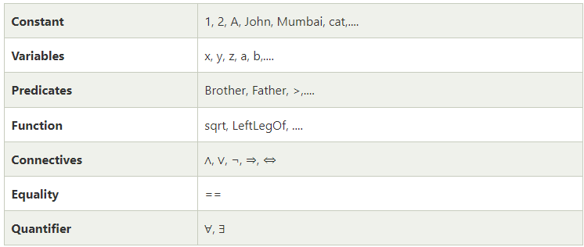
First-Order Logic in Artificial intelligence
Basic Elements of First-order logic:
Following are the basic elements of FOL syntax:

Slide 77
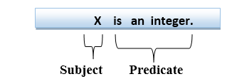
First-Order Logic in Artificial intelligence
First-order logic statements can be divided into two parts:
Subject: Subject is the main part of the statement.
Predicate: A predicate can be defined as a relation, which binds two atoms together in a statement.
Consider the statement: "x is an integer.", it consists of two parts, the first part x is the subject of the statement and second part "is an integer," is known as a predicate.

Slide 78
First-Order Logic in Artificial intelligence
Atomic sentences:
Atomic sentences are the most basic sentences of first-order logic. These sentences are formed from a predicate symbol followed by a parenthesis with a sequence of terms.
We can represent atomic sentences as Predicate (term1, term2, ......, term n).
Example: Ravi and Ajay are brothers: => Brothers(Ravi, Ajay). Simba is a Lion: => Lion (Simba).
Complex Sentences:
Complex sentences are made by combining atomic sentences using connectives.

Slide 79
First-Order Logic in Artificial intelligence
Quantifiers in First-order logic:
A quantifier is a language element which generates quantification, and quantification specifies the quantity of specimen in the universe of discourse.
These are the symbols that permit to determine or identify the range and scope of the variable in the logical expression. There are two types of quantifier:
Universal Quantifier, (for all, everyone, everything)
Existential quantifier, (for some, at least one).

Slide 80
First-Order Logic in Artificial intelligence
Universal Quantifier:
Universal quantifier is a symbol of logical representation, which specifies that the statement within its range is true for everything or every instance of a particular thing.
The Universal quantifier is represented by a symbol ∀, which resembles an inverted A.
Note: In universal quantifier we use implication "→".
If x is a variable, then ∀x is read as:
For all x
For each x
For every x.

Slide 81
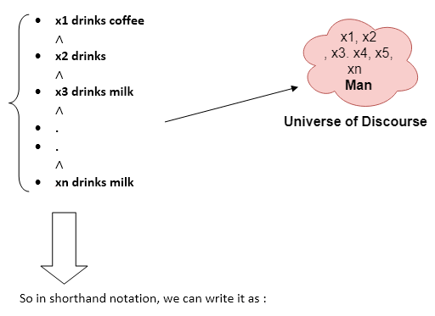
First-Order Logic in Artificial intelligence
Example:
All man drink coffee.
Let a variable x which refers to a man so all x can be represented in UOD as below:
∀x man(x) → drink (x, coffee).
It will be read as: There are all x where x is a man who drink coffee.

Slide 82
First-Order Logic in Artificial intelligence
Existential Quantifier:
Existential quantifiers are the type of quantifiers, which express that the statement within its scope is true for at least one instance of something.
It is denoted by the logical operator ∃, which resembles as inverted E. When it is used with a predicate variable then it is called as an existential quantifier.
Note: In Existential quantifier we always use AND or Conjunction symbol (∧).
If x is a variable, then existential quantifier will be ∃x or ∃(x). And it will be read as:
There exists a 'x.'
For some 'x.'
For at least one 'x.'

Slide 83
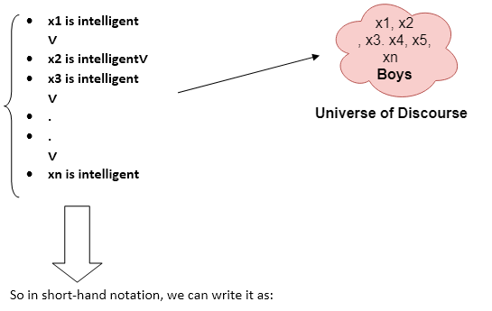
First-Order Logic in Artificial intelligence
Example:
Some boys are intelligent.
∃x: boys(x) ∧ intelligent(x)
It will be read as: There are some x where x is a boy who is intelligent.

Slide 84
First-Order Logic in Artificial intelligence
Points to remember:
The main connective for universal quantifier ∀ is implication →.
The main connective for existential quantifier ∃ is and ∧.
Properties of Quantifiers:
In universal quantifier, ∀x∀y is similar to ∀y∀x.
In Existential quantifier, ∃x∃y is similar to ∃y∃x.
∃x∀y is not similar to ∀y∃x.

Slide 85
First-Order Logic in Artificial intelligence
Some Examples of FOL using quantifier:
1. All birds fly. In this question the predicate is "fly(bird)." And since there are all birds who fly so it will be represented as follows. ∀x bird(x) →fly(x).
2. Every man respects his parent. In this question, the predicate is "respect(x, y)," where x=man, and y= parent. Since there is every man so will use ∀, and it will be represented as follows: ∀x man(x) → respects (x, parent).

Slide 86
First-Order Logic in Artificial intelligence
3. Some boys play cricket. In this question, the predicate is "play(x, y)," where x= boys, and y= game. Since there are some boys so we will use ∃, and it will be represented as: ∃x boys(x) ∧ play(x, cricket).
4. Not all students like both Mathematics and Science. In this question, the predicate is "like(x, y)," where x= student, and y= subject. Since there are not all students, so we will use ∀ with negation, so following representation for this: ¬∀ (x) [ student(x) → like(x, Mathematics) ∧ like(x, Science)].

Slide 87
Unification
What is Unification?
Unification is a process of making two different logical atomic expressions identical by finding a substitution. Unification depends on the substitution process.
It takes two literals as input and makes them identical using substitution.
Let Ψ₁ and Ψ₂ be two atomic sentences and 𝜎 be a unifier such that, Ψ₁𝜎 = Ψ₂𝜎, then it can be expressed as UNIFY(Ψ₁, Ψ₂).

Slide 88
Unification
Example: Find the MGU for Unify{King(x), King(John)}
Let Ψ₁ = King(x), Ψ₂ = King(John),
Substitution θ = {John/x} is a unifier for these atoms and applying this substitution, and both expressions will be identical.
The UNIFY algorithm is used for unification, which takes two atomic sentences and returns a unifier for those sentences (If any exist).
Unification is a key component of all first-order inference algorithms.
It returns fail if the expressions do not match with each other.
The substitution variables are called Most General Unifier or MGU.

Slide 89
Unification
E.g. Let's say there are two different expressions, P(x, y), and P(a, f(z)).
In this example, we need to make both above statements identical to each other. For this, we will perform the substitution.
P(x, y)......... (i) P(a, f(z))......... (ii)
Substitute x with a, and y with f(z) in the first expression, and it will be represented as a/x and f(z)/y.
With both the substitutions, the first expression will be identical to the second expression and the substitution set will be: [a/x, f(z)/y].

Slide 90
Unification
Following are some basic conditions for unification:
Predicate symbol must be same, atoms or expression with different predicate symbol can never be unified.
Number of Arguments in both expressions must be identical.
Unification will fail if there are two similar variables present in the same expression.

Slide 91
Unification
Implementation of the Algorithm
Step.1: Initialize the substitution set to be empty.
Step.2: Recursively unify atomic sentences:
Check for Identical expression match.
If one expression is a variable v_{i}, and the other is a term t_{i} which does not contain variable v_{i}, then:
Substitute t_{i} / v_{i} in the existing substitutions
Add t_{i} /v_{i} to the substitution setlist.
If both the expressions are functions, then function name must be similar, and the number of arguments must be the same in both the expression.

Slide 92
Unification
or each pair of the following atomic sentences find the most general unifier (If exist).
1. Find the MGU of {p(f(a), g(Y)) and p(X, X)}
Sol: S₀ => Here, Ψ₁ = p(f(a), g(Y)), and Ψ₂ = p(X, X) SUBST θ= {f(a) / X} S1 => Ψ₁ = p(f(a), g(Y)), and Ψ₂ = p(f(a), f(a)) SUBST θ= {f(a) / g(y)}, Unification failed.

Slide 93
Unification
2. Find the MGU of {p(b, X, f(g(Z))) and p(Z, f(Y), f(Y))}
Here, Ψ₁ = p(b, X, f(g(Z))) , and Ψ₂ = p(Z, f(Y), f(Y)) S₀ => { p(b, X, f(g(Z))); p(Z, f(Y), f(Y))} SUBST θ={b/Z}
S₁ => { p(b, X, f(g(b))); p(b, f(Y), f(Y))} SUBST θ={f(Y) /X}
S₂ => { p(b, f(Y), f(g(b))); p(b, f(Y), f(Y))} SUBST θ= {g(b) /Y}
S₂ => { p(b, f(g(b)), f(g(b)); p(b, f(g(b)), f(g(b))} Unified Successfully. And Unifier = { b/Z, f(Y) /X , g(b) /Y}.

Slide 94
Unification
3. Find the MGU of {p (X, X), and p (Z, f(Z))}
Here, Ψ₁ = {p (X, X), and Ψ₂ = p (Z, f(Z)) S₀ => {p (X, X), p (Z, f(Z))} SUBST θ= {X/Z} S1 => {p (Z, Z), p (Z, f(Z))} SUBST θ= {f(Z) / Z}, Unification Failed.

Slide 95
Unification
4. Find the MGU of UNIFY(prime (11), prime(y))
Here, Ψ₁ = {prime(11) , and Ψ₂ = prime(y)} S₀ => {prime(11) , prime(y)} SUBST θ= {11/y}
S₁ => {prime(11) , prime(11)} , Successfully unified. Unifier: {11/y}.

Slide 96
Unification
5. Find the MGU of Q(a, g(x, a), f(y)), Q(a, g(f(b), a), x)}
Here, Ψ₁ = Q(a, g(x, a), f(y)), and Ψ₂ = Q(a, g(f(b), a), x) S₀ => {Q(a, g(x, a), f(y)); Q(a, g(f(b), a), x)} SUBST θ= {f(b)/x} S₁ => {Q(a, g(f(b), a), f(y)); Q(a, g(f(b), a), f(b))}
SUBST θ= {b/y} S₁ => {Q(a, g(f(b), a), f(b)); Q(a, g(f(b), a), f(b))}, Successfully Unified.
Unifier: [ f(b)/x, b/y].

Slide 97
Unification
6. UNIFY(knows(Richard, x), knows(Richard, John))
Here, Ψ₁ = knows(Richard, x), and Ψ₂ = knows(Richard, John) S₀ => { knows(Richard, x); knows(Richard, John)} SUBST θ= {John/x} S₁ => { knows(Richard, John); knows(Richard, John)}, Successfully Unified. Unifier: {John/x}.

Slide 98
Resolution in FOL
Resolution
Resolution is a theorem proving technique that proceeds by building refutation proofs, i.e., proofs by contradictions. It was invented by a Mathematician John Alan Robinson in the year 1965.
Resolution is used, if there are various statements are given, and we need to prove a conclusion of those statements. Unification is a key concept in proofs by resolutions. Resolution is a single inference rule which can efficiently operate on the conjunctive normal form or clausal form.
Clause: Disjunction of literals (an atomic sentence) is called a clause. It is also known as a unit clause.
Conjunctive Normal Form: A sentence represented as a conjunction of clauses is said to be conjunctive normal form or CNF.

Slide 99
Resolution in FOL
Steps for Resolution:
Conversion of facts into first-order logic.
Convert FOL statements into CNF
Negate the statement which needs to prove (proof by contradiction)
Draw resolution graph (unification).

Slide 100
Resolution in FOL
Example:
John likes all kind of food.
Apple and vegetable are food
Anything anyone eats and not killed is food.
Anil eats peanuts and still alive
Harry eats everything that Anil eats.
Prove by resolution that John likes peanuts.

Slide 101
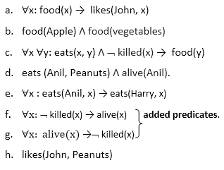
Resolution in FOL
Step-1: Conversion of Facts into FOL
In the first step we will convert all the given statements into its first order logic.

Slide 102
Resolution in FOL
Step-2: Conversion of FOL into CNF
In First order logic resolution, it is required to convert the FOL into CNF as CNF form makes easier for resolution proofs.
Eliminate all implication (→) and rewrite (P →Q = ~P VQ)
∀x ¬ food(x) V likes(John, x)
food(Apple) Λ food(vegetables)
∀x ∀y ¬ [eats(x, y) Λ ¬ killed(x)] V food(y)
eats (Anil, Peanuts) Λ alive(Anil)
∀x ¬ eats(Anil, x) V eats(Harry, x)
∀x¬ [¬ killed(x) ] V alive(x)
∀x ¬ alive(x) V ¬ killed(x)
likes(John, Peanuts).

Slide 103
Resolution in FOL
Move negation (¬)inwards and rewrite
∀x ¬ food(x) V likes(John, x)
food(Apple) Λ food(vegetables)
∀x ∀y ¬ eats(x, y) V killed(x) V food(y)
eats (Anil, Peanuts) Λ alive(Anil)
∀x ¬ eats(Anil, x) V eats(Harry, x)
∀x ¬killed(x) ] V alive(x)
∀x ¬ alive(x) V ¬ killed(x)
likes(John, Peanuts).

Slide 104
Resolution in FOL
Rename variables or standardize variables
∀x ¬ food(x) V likes(John, x)
food(Apple) Λ food(vegetables)
∀y ∀z ¬ eats(y, z) V killed(y) V food(z)
eats (Anil, Peanuts) Λ alive(Anil)
∀w¬ eats(Anil, w) V eats(Harry, w)
∀g ¬killed(g) ] V alive(g)
∀k ¬ alive(k) V ¬ killed(k)
likes(John, Peanuts).

Slide 105
Resolution in FOL
Eliminate existential instantiation quantifier by elimination. In this step, we will eliminate existential quantifier ∃, and this process is known as Skolemization. But in this example problem since there is no existential quantifier so all the statements will remain same in this step.

Slide 106
Resolution in FOL
Drop Universal quantifiers. In this step we will drop all universal quantifier since all the statements are not implicitly quantified so we don't need it.
¬ food(x) V likes(John, x)
food(Apple)
food(vegetables)
¬ eats(y, z) V killed(y) V food(z)
eats (Anil, Peanuts)
alive(Anil)
¬ eats(Anil, w) V eats(Harry, w)
killed(g) V alive(g)
¬ alive(k) V ¬ killed(k)
likes(John, Peanuts).
Note: Statements "food(Apple) Λ food(vegetables)" and "eats (Anil, Peanuts) Λ alive(Anil)" can be written in two separate statements.

Slide 107
Resolution in FOL
Step-3: Negate the statement to be proved
In this statement, we will apply negation to the conclusion statements, which will be written as ¬likes(John, Peanuts)
Step-4: Draw Resolution graph:
Now in this step, we will solve the problem by resolution tree using substitution. For the above problem, it will be given as follows:

Slide 108
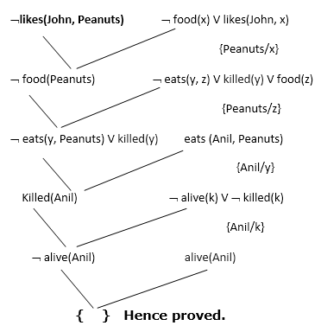
Resolution in FOL

Slide 109
Resolution in FOL
Explanation of Resolution graph:
In the first step of resolution graph, ¬likes(John, Peanuts) , and likes(John, x) get resolved(canceled) by substitution of {Peanuts/x}, and we are left with ¬ food(Peanuts)
In the second step of the resolution graph, ¬ food(Peanuts) , and food(z) get resolved (canceled) by substitution of { Peanuts/z}, and we are left with ¬ eats(y, Peanuts) V killed(y) .
In the third step of the resolution graph, ¬ eats(y, Peanuts) and eats (Anil, Peanuts) get resolved by substitution {Anil/y}, and we are left with Killed(Anil) .
In the fourth step of the resolution graph, Killed(Anil) and ¬ killed(k) get resolve by substitution {Anil/k}, and we are left with ¬ alive(Anil) .
In the last step of the resolution graph ¬ alive(Anil) and alive(Anil) get resolved.

Slide 110
Forward chaining
Inference engine:
The inference engine is the component of the intelligent system in artificial intelligence, which applies logical rules to the knowledge base to infer new information from known facts. The first inference engine was part of the expert system. Inference engine commonly proceeds in two modes, which are:
Forward chaining
Backward chaining

Slide 111
Forward chaining
Forward Chaining
Forward chaining is also known as a forward deduction or forward reasoning method when using an inference engine. Forward chaining is a form of reasoning which start with atomic sentences in the knowledge base and applies inference rules (Modus Ponens) in the forward direction to extract more data until a goal is reached.
The Forward-chaining algorithm starts from known facts, triggers all rules whose premises are satisfied, and add their conclusion to the known facts. This process repeats until the problem is solved.

Slide 112
Forward chaining
Properties of Forward-Chaining:
It is a down-up approach, as it moves from bottom to top.
It is a process of making a conclusion based on known facts or data, by starting from the initial state and reaches the goal state.
Forward-chaining approach is also called as data-driven as we reach to the goal using available data.
Forward -chaining approach is commonly used in the expert system, such as CLIPS, business, and production rule systems.

Slide 113
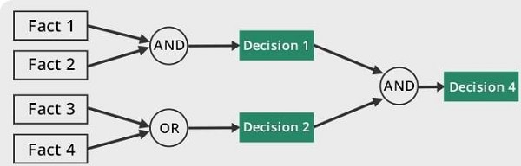
Forward chaining

Slide 114
Forward chaining
Consider the following famous example which we will use in both approaches: Example:
"As per the law, it is a crime for an American to sell weapons to hostile nations. Country A, an enemy of America, has some missiles, and all the missiles were sold to it by Robert, who is an American citizen."
Prove that "Robert is criminal."
To solve the above problem, first, we will convert all the above facts into first-order definite clauses, and then we will use a forward-chaining algorithm to reach the goal.

Slide 115
Forward chaining
It is a crime for an American to sell weapons to hostile nations. (Let's say p, q, and r are variables) American (p) ∧ weapon(q) ∧ sells (p, q, r) ∧ hostile(r) → Criminal(p) ...(1)
Country A has some missiles. ∃ p Owns(A, p) ∧ Missile(p). It can be written in two definite clauses by using Existential Instantiation, introducing new Constant T1. Owns(A, T1) ......(2) Missile(T1) .......(3)

Slide 116
Forward chaining
All of the missiles were sold to country A by Robert. ∀ Missiles(p) ∧ Owns (A, p) → Sells (Robert, p, A) ......(4)
Missiles are weapons. Missile(p) → Weapons (p) .......(5)
Enemy of America is known as hostile. Enemy(p, America) →Hostile(p) ........(6)
Country A is an enemy of America. Enemy (A, America) .........(7)
Robert is American American(Robert). ..........(8)

Slide 117
Forward chaining
Forward chaining proof:
Step-1:
In the first step we will start with the known facts and will choose the sentences which do not have implications, such as: American(Robert), Enemy(A, America), Owns(A, T1), and Missile(T1). All these facts will be represented as below.

Slide 118
Forward chaining
Step-2:
At the second step, we will see those facts which infer from available facts and with satisfied premises.
Rule-(1) does not satisfy premises, so it will not be added in the first iteration.
Rule-(2) and (3) are already added.
Rule-(4) satisfy with the substitution {p/T1}, so Sells (Robert, T1, A) is added, which infers from the conjunction of Rule (2) and (3).
Rule-(6) is satisfied with the substitution(p/A), so Hostile(A) is added and which infers from Rule-(7).

Slide 119
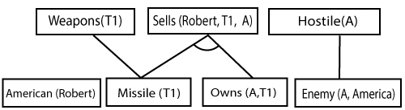
Forward chaining

Slide 120
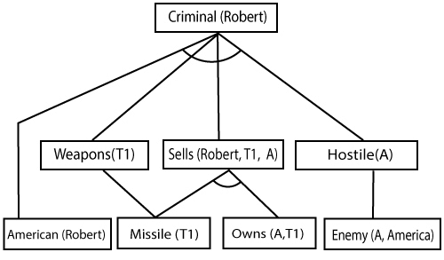
Forward chaining
Step-3:
At step-3, as we can check Rule-(1) is satisfied with the substitution {p/Robert, q/T1, r/A}, so we can add Criminal(Robert) which infers all the available facts. And hence we reached our goal statement.

Slide 121
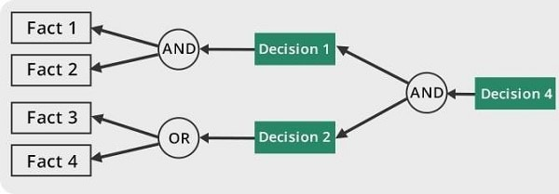
Backward Chaining

Slide 122
Backward Chaining
Backward-chaining is also known as a backward deduction or backward reasoning method when using an inference engine. A backward chaining algorithm is a form of reasoning, which starts with the goal and works backward, chaining through rules to find known facts that support the goal.
Properties of backward chaining:
It is known as a top-down approach.
Backward-chaining is based on modus ponens inference rule.
In backward chaining, the goal is broken into sub-goal or sub-goals to prove the facts true.

Slide 123
Backward Chaining
It is called a goal-driven approach, as a list of goals decides which rules are selected and used.
Backward -chaining algorithm is used in game theory, automated theorem proving tools, inference engines, proof assistants, and various AI applications.
The backward-chaining method mostly used a depth-first search strategy for proof.

Slide 124
Backward Chaining
Example:
In backward-chaining, we will use the same above example, and will rewrite all the rules.
American (p) ∧ weapon(q) ∧ sells (p, q, r) ∧ hostile(r) → Criminal(p) ...(1) Owns(A, T1) ........(2)
Missile(T1)
?p Missiles(p) ∧ Owns (A, p) → Sells (Robert, p, A) ......(4)
Missile(p) → Weapons (p) .......(5)
Enemy(p, America) →Hostile(p) ........(6)
Enemy (A, America) .........(7)
American(Robert). ..........(8)

Slide 125

Backward Chaining
Backward-Chaining proof:
In Backward chaining, we will start with our goal predicate, which is Criminal(Robert), and then infer further rules.
Step-1:
At the first step, we will take the goal fact. And from the goal fact, we will infer other facts, and at last, we will prove those facts true. So our goal fact is "Robert is Criminal," so following is the predicate of it.

Slide 126
Backward Chaining
Step-2:
At the second step, we will infer other facts form goal fact which satisfies the rules. So as we can see in Rule-1, the goal predicate Criminal (Robert) is present with substitution {Robert/P}. So we will add all the conjunctive facts below the first level and will replace p with Robert.
Here we can see American (Robert) is a fact, so it is proved here.

Slide 127
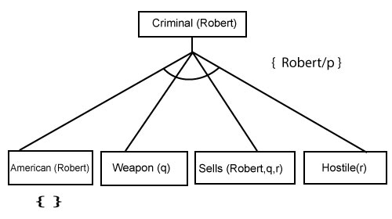
Backward Chaining

Slide 128
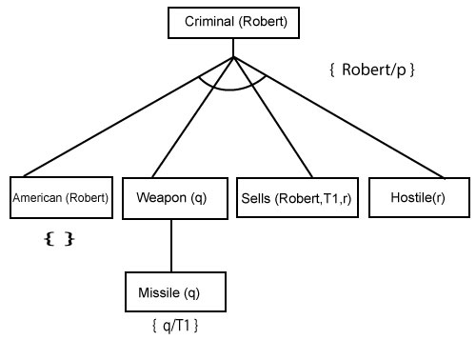
Backward Chaining
Step-3:t At step-3, we will extract further fact Missile(q) which infer from Weapon(q), as it satisfies Rule-(5). Weapon (q) is also true with the substitution of a constant T1 at q.

Slide 129
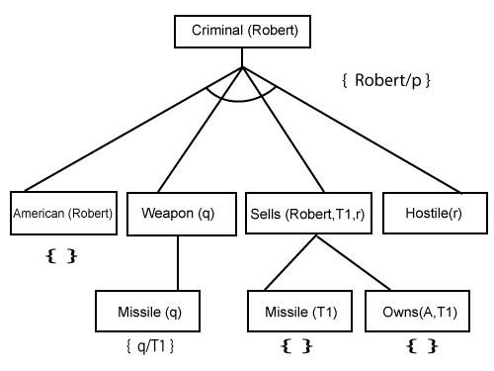
Backward Chaining
Step-4:
At step-4, we can infer facts Missile(T1) and Owns(A, T1) form Sells(Robert, T1, r) which satisfies the Rule- 4, with the substitution of A in place of r. So these two statements are proved here.

Slide 130
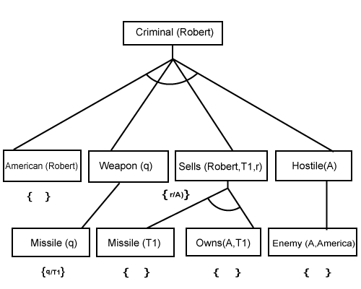
Backward Chaining
Step-5:
At step-5, we can infer the fact Enemy(A, America) from Hostile(A) which satisfies Rule- 6. And hence all the statements are proved true using backward chaining.

Slide 131
Backward Chaining
1) Gita loves all types of clothes.
2) Suits are clothes.
3) Jackets are clothes.
4)Anything any wear and isn’t bad is clothes.
5) Sita wears skirt and is good.
6) Renu wears anything Sita wears.
Apply backward chaining and prove that Gita loves Kurtis.

Slide 132
Backward Chaining
Solution: Convert the given axioms into FOPL as:
x: clothes(x)?loves(Gita, x).
Suits(x)?Clothes(x).
Jackets(x)?Clothes(x).
wears(x,y)?? ¬bad(y)?Clothes(x)
wears(Sita,skirt)? ¬good(Sita)
wears(Sita,x)?wears(Renu,x)
To prove: Gita loves Kurtis.
FOPL: loves(Gita, Kurtis).

Slide 133
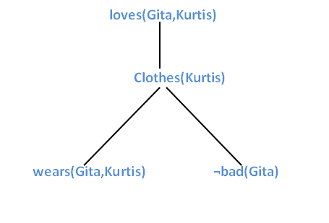
Backward Chaining
Apply backward chaining in the below graph:
It is clear from the above graph Gita wears Kurtis and does not look bad. Hence, Gita loves Kurtis.

Slide 134
Backward Chaining
Example : https://analyticssteps.com/blogs/forward-chaining-vs-backward-chaining

